Slide 1
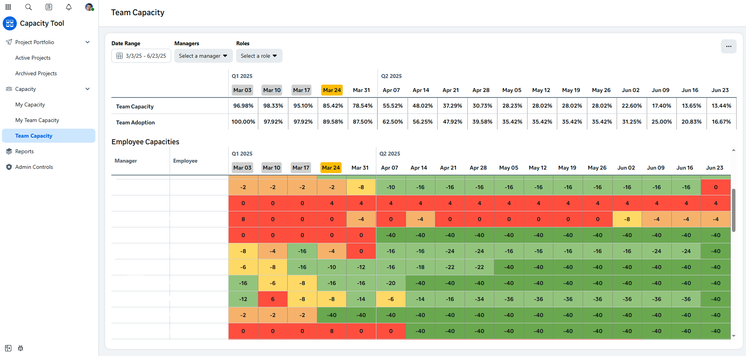

Intern Apps
Capacity Automation
The Business Need
Meta’s Creative Audio Team was using several separate systems for intake processes, capacity planning and evaluations, creating inefficiencies in managing resources and tracking progress on their work.
What We Did
Affirma created a custom Capacity Tool integrated into Meta's internal platform, consolidating intake processes, resource planning and evaluation systems into one streamlined tool. Tasks are viewable in the Intern application, with data synchronized across systems, and reporting is enhanced through Tableau and Unidash. Our team provides ongoing engineering and project management support, ensuring the tool remains functional, troubleshooting any issues, and implementing new features based on user feedback.
Integrations & Technology
Impact
Streamlined resource management & planning
Elimination of redundancies across systems
Enhanced reporting & data synchronization
Tasks
Tableau
Unidash

